Slide 1
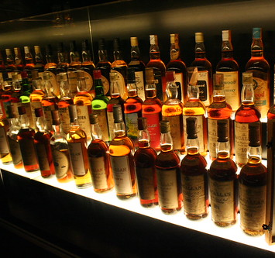
DIAGEO AMERICAS SWOT ANALYSIS

Slide 2
ANALYSIS FOCUS: total sales, BOTTLE PRICE, & JIM BEAM WHISKEY ANALYSIS Summary stats: IOWA liquor sales DATASET

Slide 3
IN THIS PRESENTATION, WE WILL OBSERVE STRENGTHS, WEAKNESSES, OPPORTUNITIES & THREATS REVOLVING AROUND THE TOTAL SALES revenue of Diageo Americas. HERE IS DIAGEO AMERICAS’ TOTAL SALES REVENUE WHEN COMPARED WITH OUR “COMPETITORS”.

Slide 4
DIAGEO AMERICA’S TOP 10 PERFORMING DRINKS BY THEIR TOTAL REVENUE

Slide 5
AVERAGE BOTTLE PRICE: DIAGEO AMERICAS VS. JIM BEAM BRANDS

Slide 6
AVERAGE BOTTLE PRICE (WHISKEY): DIAGEO AMERICAS VS. JIM BEAM BRANDS

Slide 7
DIAGEO AMERICAS WHISKEY INVENTORY OUTWEIGHS THE COMPETITORS with 366,748 bottles of whiskey in our inventory. Whiskey is our highest performer in total revenue.

Slide 8
JIM BEAM BRANDS STUGGLES TO CHALLENGE OUR WHISKEY INVENTORY IN QUANTITY, QUALITY, OR TOTAL SALES.

Slide 9
OUR INVENTORY COUNT FOR WHISKEY MAY BE FAVORABLE, BUT JIM BEAM ON AVERAGE PRICE PER BOTTLE, PROVIDES BETTER AFFORDABILITY IN WHISKEY.

Slide 10
JIM BEAM BRANDS’ TOP PERFORMERS ARE ALL AVERAGELY CHEAP. HIGHER VOLUME IN WHISKEY INVENTORY WITH GOOD AVERAGE PRICES PER BOTTLE MAY PROVE TO BE OUR ONLY “THREAT”.

Slide 11
A STAGGERING DISCOVERY of kpi:
IF DIAGEO AMERICAS’ SEAGRAM’S 7 CROWN BL WHISKEY SOLD AT AN AVERAGE OF $16.00 PER BOTTLE INSTEAD OF $12.00, WE WOULD SEE A TOTAL REVENUE OF ROUGHLY $5.6 MILLION. OUR CHEAPEST TOP-SELLING WHISKEY WOULD HAVE THEN OUTPERFORMED JIM BEAM’S #1 WHISKEY PRODUCT IN TOTAL REVENUE.
EL ROLLINS

